Slide 1

Life Expectancy Among Countries (2000-2015)
Helena Van Ess
Notes:
Hello my name is Helena Van Ess, data visualization designer for Worldwide Analytics and I am pleased with the opportunity to provide life expectancy related metrics to all of you as policy makers of your countries. I have hopes that after this presentation each of you will take away various insights to maintain or increase life expectancy in your countries. I will be analyzing various metrics with efforts to show a possible relationship to life expectancy across the world. I will be exploring various metrics and dimensions including: status and education, status and morality, healthcare expenditure and life expectancy, BMI and life expectancy, and education and life expectancy. I challenge all of you to think about how these metrics can be improved in your countries in efforts to increase life expectancy. How your current policies end to increase life expectancy? And what policies can you implement based on the data?

Slide 2

About the Data
Data of 193 countries from the years 2000-2015
The Global Health Observatory (GHO) data repository under World Health Organization (WHO) keeps track of the health status and other health metrics
The life expectancy data set includes many metrics that can be related to life expectancy
There are some metrics that seem to have a potential relationship with life expectancy
From this data, one can see what metrics should be improved in efforts to increase life expectancy
Notes:
The life expectancy dataset was obtained by the GHO and the WHO, they keep track of health-related metrics across the world. These metrics are from the year 2000 to 2015. The metrics included in this dataset that will be used are year, life expectancy, adult morality, infant deaths, BMI, under-five-deaths, total expenditure, thinness 10-19 years, thinness 5-9 years and schooling. Along with other dimensions like country and status. These are the metrics and dimensions that I found to have a potential relationship with the life expectancy within countries. By narrowing down the metrics and dimensions, one can then analyze the data and see what should be improved in efforts to increase life expectancy.

Slide 3
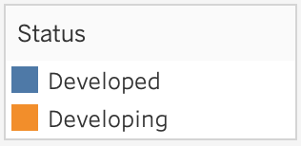
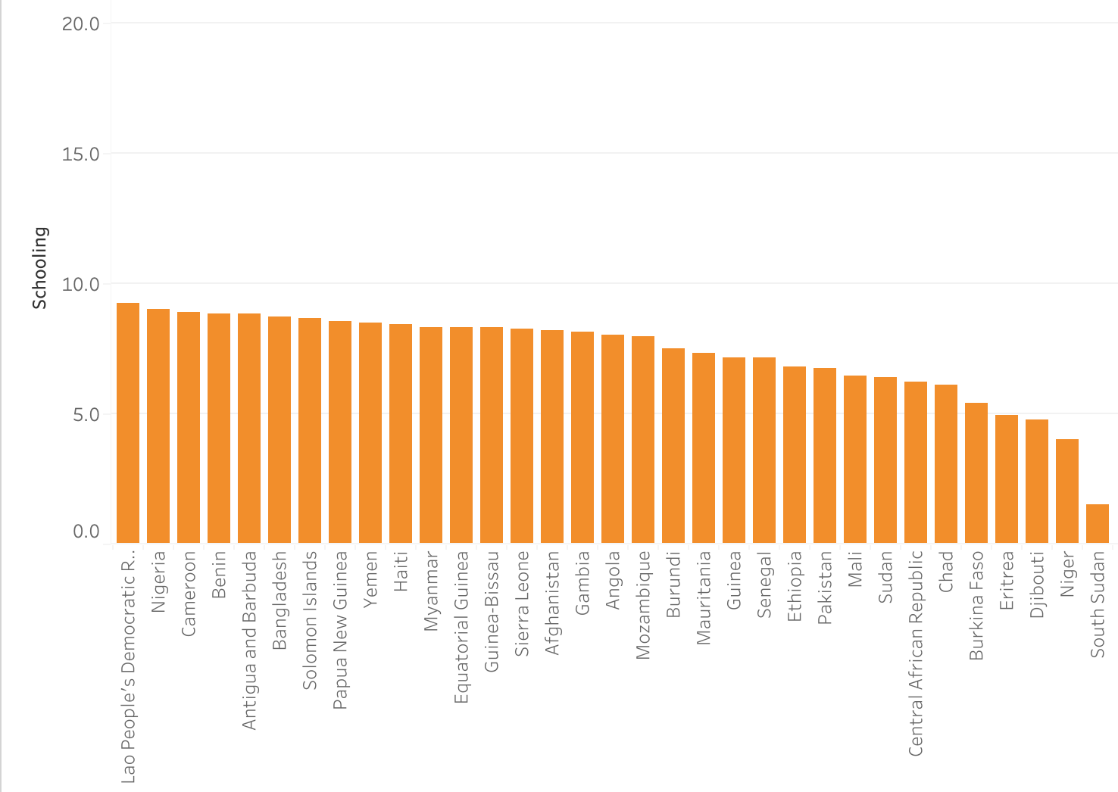
Developed Countries Seem to Have a Higher Level of Education
All developed countries are ranked in the top 33% of schooling
All the countries with less education on average are developing countries
Notes:
While analyzing the data, I found some metrics that seem to relate to status very well. On average, developed countries have a higher level of education. All developed countries are within the top 33% of countries with the highest schooling. This being said, the bottom 67% of countries with the lowest education on average are held by those countries whose status is still developing. This infers that as the country develops, the education level will too. Also promoting education policies within your countries will help the development within each of your countries.

Slide 4
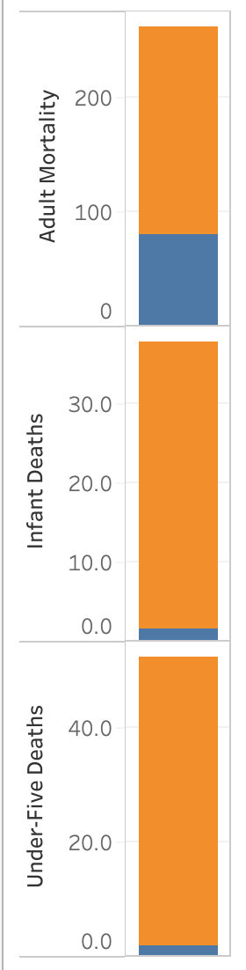
Morality Among Countries by Status
Developing countries have a higher morality than developed countries
All metrics are per 1,000
Adult morality is 15-60 years-old
Notes:
The life expectancy for developing countries on average is 67.1 years. The average life expectancy for developed countries is 79.2 years. Morality within the 3 categories, “Under-Five-Deaths,” “infant Deaths,” and “Adult Morality” all are significantly higher in developing countries on average per 1,000 people. This graph indicated that developed countries have less deaths on average. On average developing countries have 28x more under-five-deaths than developed countries. On average developing countries have 24x more infant deaths. Lastly, developing countries have 2.3x more adult deaths.
Does this mean that developing countries should focus more on healthcare expenditure?

Slide 5
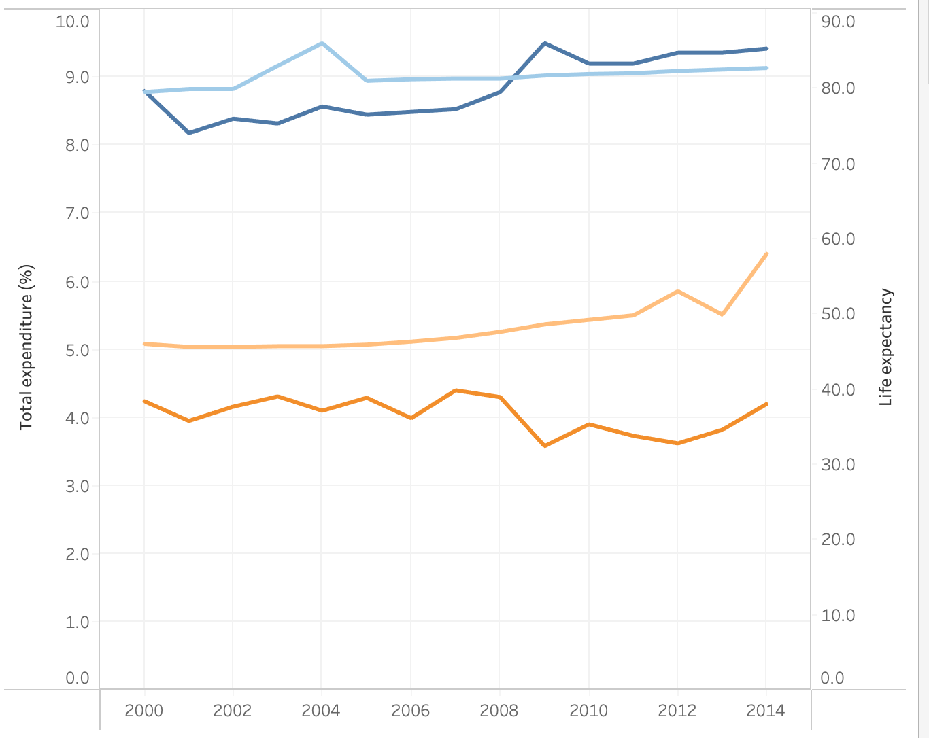
Higher Healthcare Expenditure Results in a Higher Life Expectancy
Australia Avg. Life Expectancy
Australia Avg. Total Expenditure
CAR Avg. Life Expectancy
CAR Avg.Total Expenditure
Notes:
Australia is one of the top preforming countries based off the metrics given in the dataset as well as a developed country. The Central African Republic is one of the bottom most preforming countries as well as a developing country. Total expenditure is the average government expenditure on health as a percentage of total government expenditure (%). The relationship between healthcare expenditure and life expectancy has a potential positive relationship, One can see from looking at the graph that Australia has significant higher healthcare expenditure compared to CAR. Then one can see Australia has a significantly higher life expectancy compared to CAR. In 2015, Australia had 123.8% higher healthcare percentage than CAR resulting in a 42.6% higher life expectancy. Australia remains a great example of how investing in a higher healthcare expenditure (%) can maintain and even grow your country’s life expectancy.

Slide 6
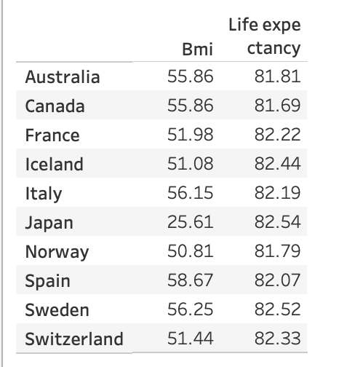
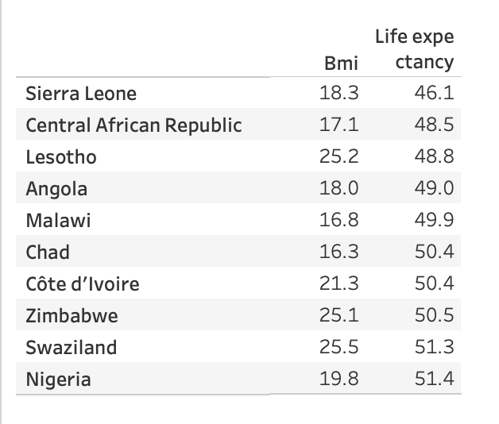
BMI Among Top and Bottom Countries
Top 10 Life Expectancy Country’s BMI
Bottom 10 Life Expectancy Country’s BMI
Notes:
While analyzing BMI within countries and their life expectancy, I found there to be an interesting trend. In the top 10 life expectancy countries, there are significantly higher BMI than bottom 10 life expectancy. I found this to be very interesting because I thought that it would have been the opposite due to the average healthy BMI in adults being 18.5 to 24. (https://www.cdc.gov/healthyweight/assessing/bmi/adult_bmi/index.html).

Slide 7
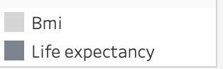
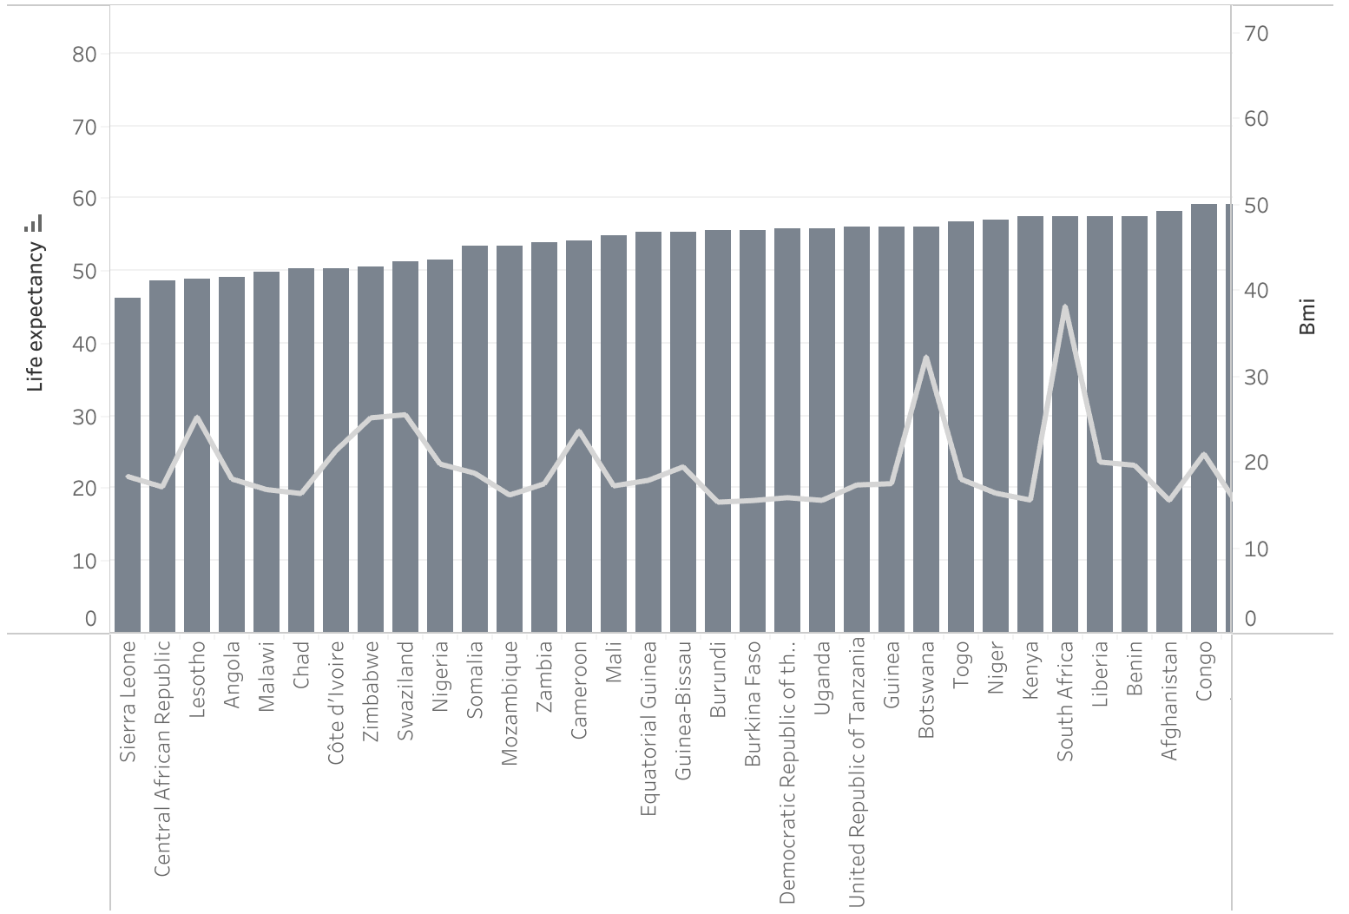
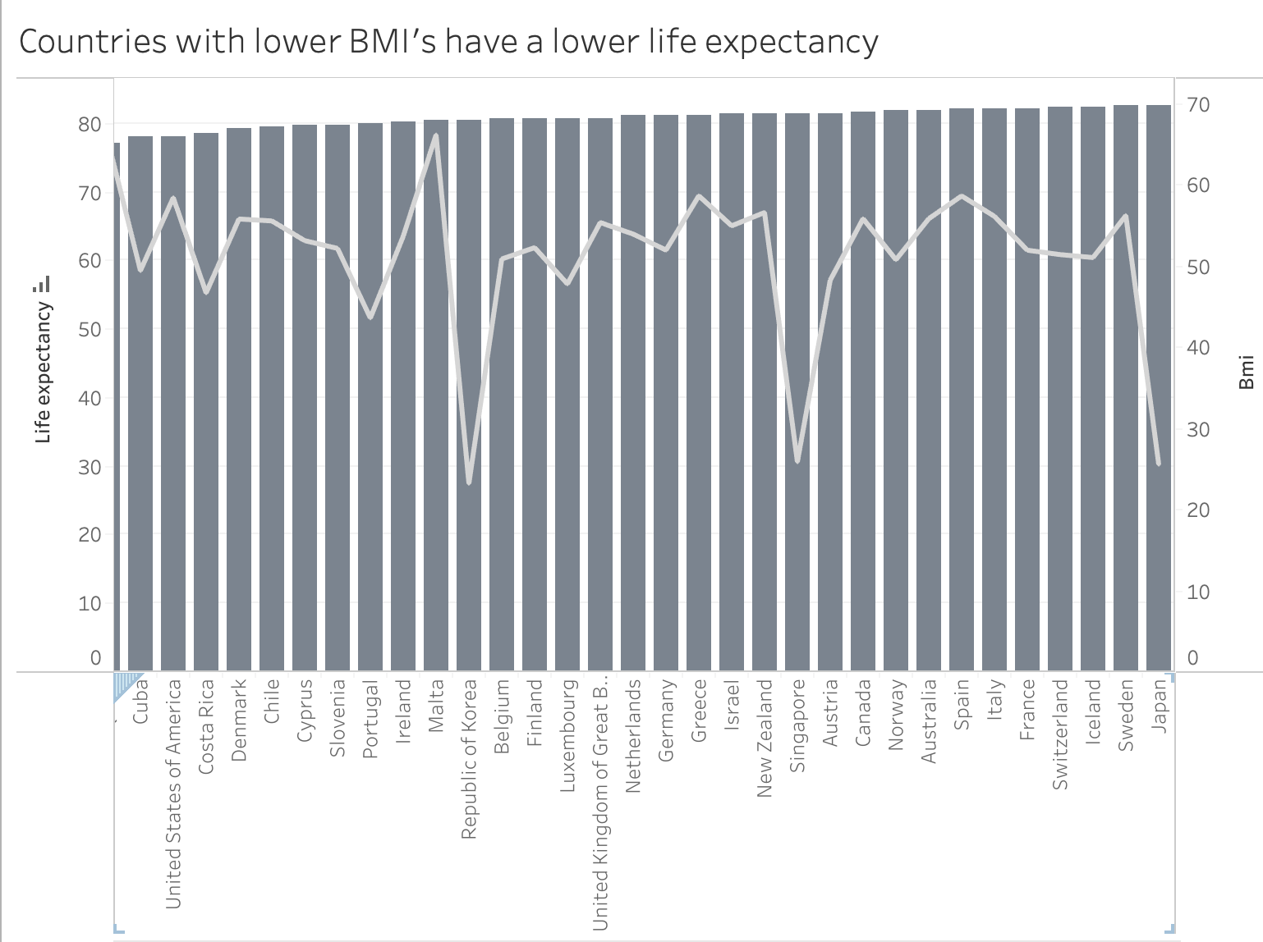
Countries With Lower BMI’s Have a Lower Life Expectancy
Notes:
Touching base on the slide before, countries with lower BMI’s maintain a lower life expectancy. As this graph increases to the top life expectancies, BMI jumps into the 70s and 80s from the 20s-40s as seen here with the bottom life expectancy countries on the graph to the left.

Slide 8
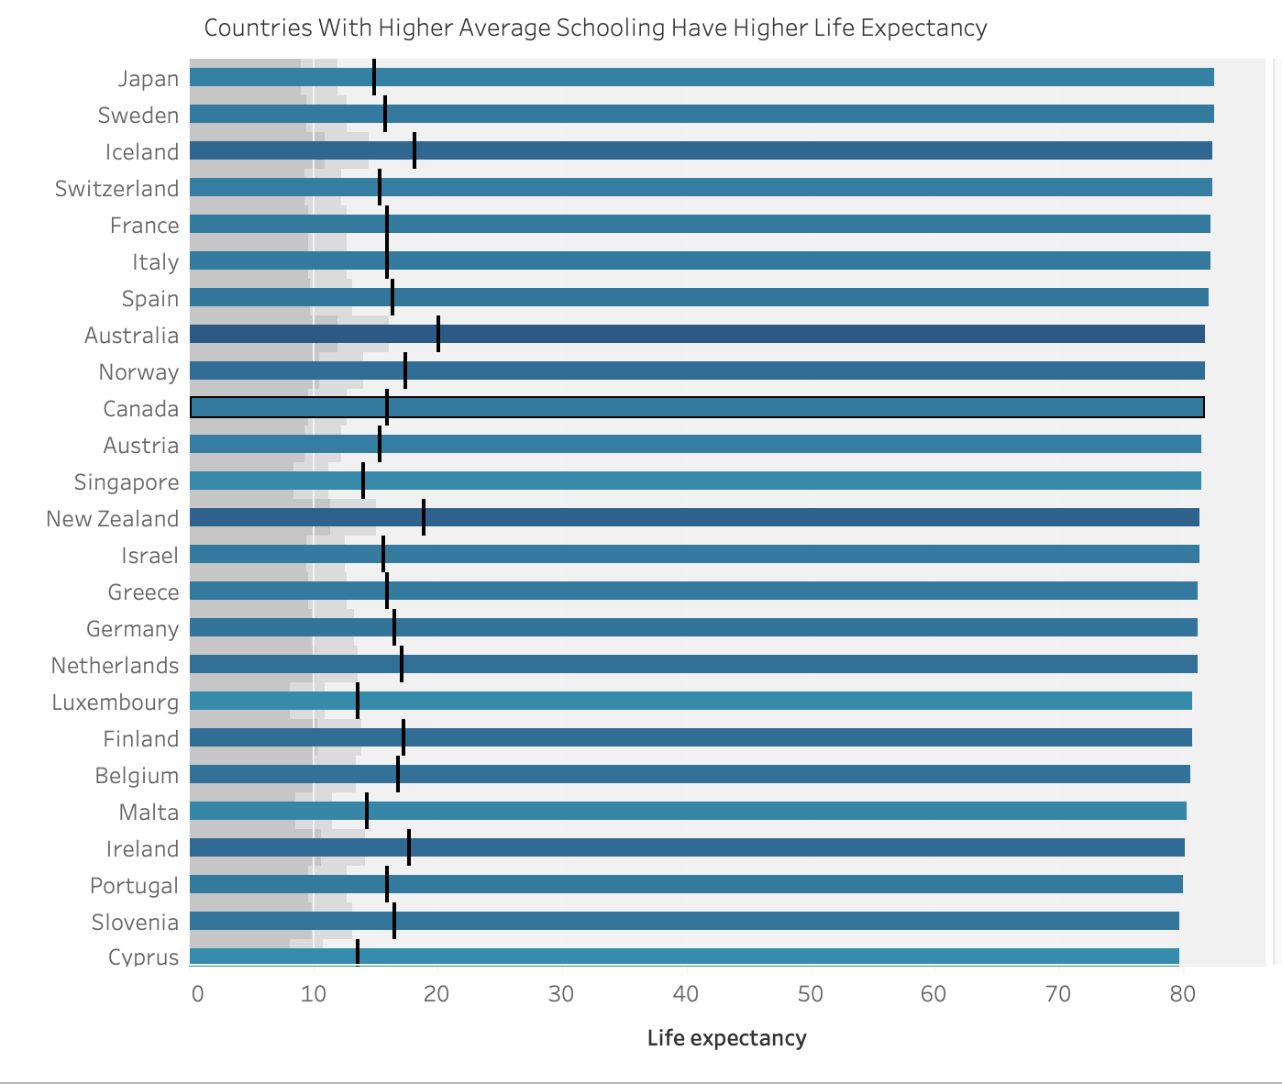
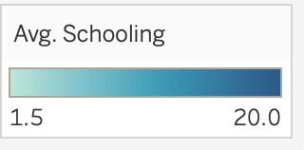
Countries that Attend More Years of School on Average, Have a Higher Life Expectancy
Notes:
Looking at this graph, one can see that the countries with a long bar length, indicating a high life expectancy, have darker blue colors. This indicates that these countries also have a higher level of education in years on average. Countries that attend more years of school on average, seem to have a higher life expectancy. The black line within the graphs show the average schooling that is also color coded to show the change. As the chart progresses downward, the colors begin to become lighter, the bottom average life expectancy countries all have light colored bars.

Slide 9
Key Insights
Status
Developing countries have higher thinness in 5–9-year-olds
Developed countries have a higher level of education
Developed countries have less morality per 1,000
Developed Countries have higher life expectancy
Life expectancy seem to have a possible positive relationship with:
Healthcare expenditure
Average years in school
BMI
Notes:
While examining the relationship within these metrics, one can conclude that life expectancy has a potential possible relationship with healthcare expenditure, average schooling in years, and BMI. One can also see that the status of the countries also relate with the metrics that seem to affect life expectancy.

Slide 10
Recommendations
Increase schooling
Invest in education, affordable education, technology integration
Increase healthcare expenditure
Invest more into heathcare, improve health insurance
Increase BMI
School meal programs, public health campaigns
Converting developing countries to developed
Invest in the previous policies and healthcare development
Notes:
Regarding the data set, there are a couple policies that you as the policy makers of your country should implement. In order to improve education to increase the average years in school, some policies that one should consider implementing are; increasing government spending on school infrastructure, more textbooks, and materials to enhance education. Reducing tuition fees to make higher education more accessible within the country or providing more scholarships/financial aid. Lastly, Integrating technology to increase digital resources and online learning.
In regard to increasing healthcare expenditure, one policy that could be implemented is to allocate a higher percentage of the country’s budget to healthcare. Another policy would be to increase or expand health insurance to decrease the amount of pay-out-of-pocket expenses.
To increase BMI and decrease the thinness rate among countries, countries should consider implementing school meal programs and introducing public health campaigns through media to focus on nutritious foods and weight management.
Lastly, developing countries should focus on the policies listed above to help expedite the time it will take for their countries to become developed.

Slide 11
Works Cited
Slide 1 photo: https://www.google.com/url?sa=i&url=https%3A%2F%2Fwww.istockphoto.com%2Fphotos%2Flife-expectancy&psig=AOvVaw0I6RQr4T3uvKI9j1oN5r4e&ust=1700092906270000&source=images&cd=vfe&opi=89978449&ved=0CBIQjRxqFwoTCNCu--PZxIIDFQAAAAAdAAAAABAE
Slide 10 photo: https://www.google.com/url?sa=i&url=https%3A%2F%2Fwnyt.com%2Ftop-stories%2Fwnyt-health-report%2Freports-find-americans-life-expectancy-lowest-in-26-years%2F&psig=AOvVaw0I6RQr4T3uvKI9j1oN5r4e&ust=1700092906270000&source=images&cd=vfe&opi=89978449&ved=0CBIQ
Tableau workbook “Life Expectancy – HelenaVanEss”
https://www.kaggle.com/datasets/kumarajarshi/life-expectancy-who
https://www.cdc.gov/healthyweight/assessing/bmi/adult_bmi/index.html
Notes:
Here is my works cited.

Slide 12
Thank you!
Notes:
Thank you for listening! Any questions?

